Slide 1
1.Title slide: project title, presenter name, and date
Introduction: project’s overview and goals, explanation of the problem being investigated
Background: previous research and findings related to lead exposure and crime rates, explanation of how lead exposure can affect behavior
Data collection and analysis: explain data sources, data cleaning and preparation process, also statistical methods used for analysis
Results: results of the analysis, graphs and charts
Discussion: the relationship between lead exposure and crime rates, explain the observed correlations
Limitations: any limitations of the study
Conclusion: summarize project findings
References
Questions and answers

Slide 2

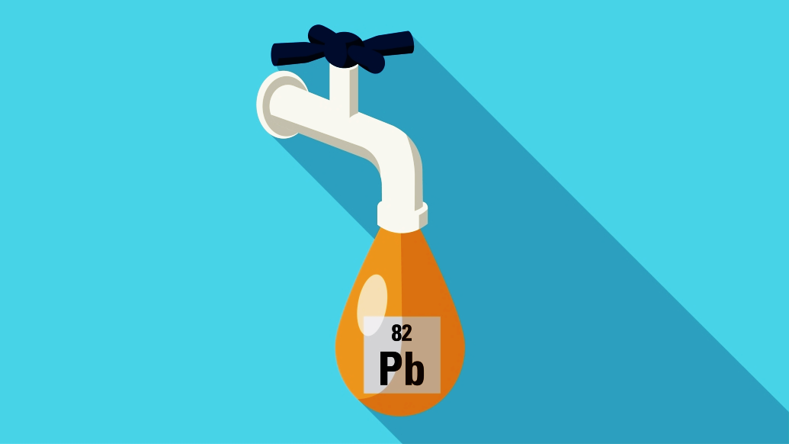
IS OUR WATER safe ?
ANALYSIS OF LEAD EXPOSURE vs CRIME RATES IN THE US
GROUP 5

Slide 3
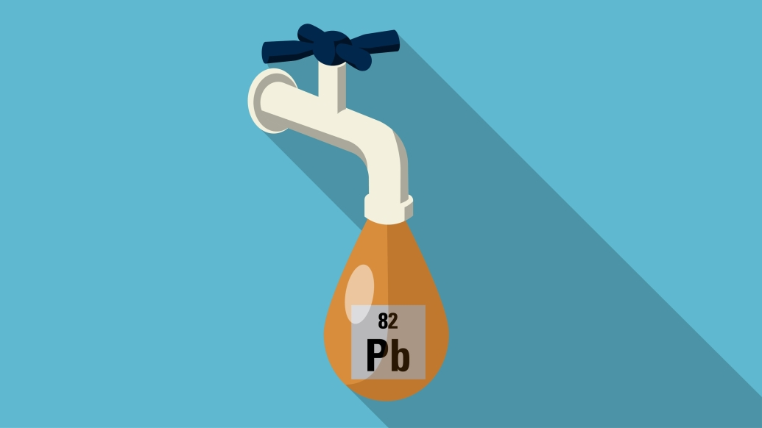

OUTLINE
Sources of lead exposure and its health effects
Discuss the statistical significance of the correlation
Call to action
Background
Results
Conclusion
1
3
5
2
4
6
Goal
Data Analysis
Limitations
Correlation between crime rates and the level of toxins
Crime rate data vs water quality data
Potential confounding variables

Slide 4

GOALS
INVESTIGATE
SOLUTIONS
How lead exposure from lead pipes can potential link to criminal behavior
Address the issue of lead exposure to prevent potential negative outcomes
EXPLORE
ANALYZE
The relationship between lead exposure and crime rates in different states of the U.S
Crime rates in areas with known lead pipe infrastructure

Slide 5
DATA SOURCE AND CLEANING
LEAD SERVICE LINE DATA
CHELATION DOCTORS
From the Natural Resources Defense Council (NRDC):https://www.nrdc.org/resources/lead-pipes-are-widespread-and-used-every-state. We cleaned, processed data to extract info on lead pipes and their locations
The American College for Advancement in Medicine (ACAM) maintains a list of licensed doctors who can perform chelation therapy
FBI VIOLENCE DATA
HEALTH PROBLEMS RELATED TO LEAD EXPOSURE
From Uniform Crime Reporting (UCR) program: https://ucr.fbi.gov/crime-in-the-u.s/2016/crime-in-the-u.s.-2016/topic-pages/tables/table-3. We cleaned, processed data to extract info on violent crimes and their locations
SOURCES OF DATA
From the Indiana State Department of Heath:https://www.in.gov/health/files/Pb_behavior_problems_and_violence_fact_sheet.pdf.
BASIC LEAD IN DRINKING WATER
MISSOURI CORRELATION DATA
From the Environmental Protection Agency (EPA): https://www.epa.gov/ground-water-and-drinking-water/basic-information-about-lead-drinking-water.
From the Uniform Crime Reporting (URC). We also used spreadsheets inventorying lead service lines to correlate the data

Slide 6
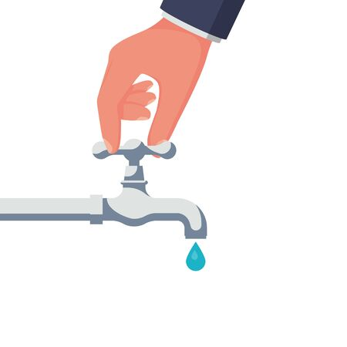
SOURCES OF LEAK EXPOSURE
Lead service line - A major source of lead contamination in water
Copper pipe with lead solder - installed before 1986 and contained high lead levels
Faucets - may contain lead
Galvanized pipe - lead particles can attach to pipes
Lead goose necks - connect to lead service line to main water line
** The contamination is more severe when water has high acidity or low mineral content

Slide 7







THE DAMAGING EFFECTS
Absorb 4-5 times more than adults
Memory loss, lack of concentration, irritability, depression
High blood pressure, anemia, and other health problems
Behavior problems, lower IQ,
learning disabilities
Miscarriage, premature birth, reduced fetal growth or lower birth weight
Cognitive issues, impaired executive functions, abnormal social behavior
Decreased bone and muscle growth, damage nervous system, heart, and kidneys
** Children with serious lead-related neurological impacts are less likely to graduate from high school and are more prone to delinquency, teen pregnancy, violent crime, and incarceration

Slide 8
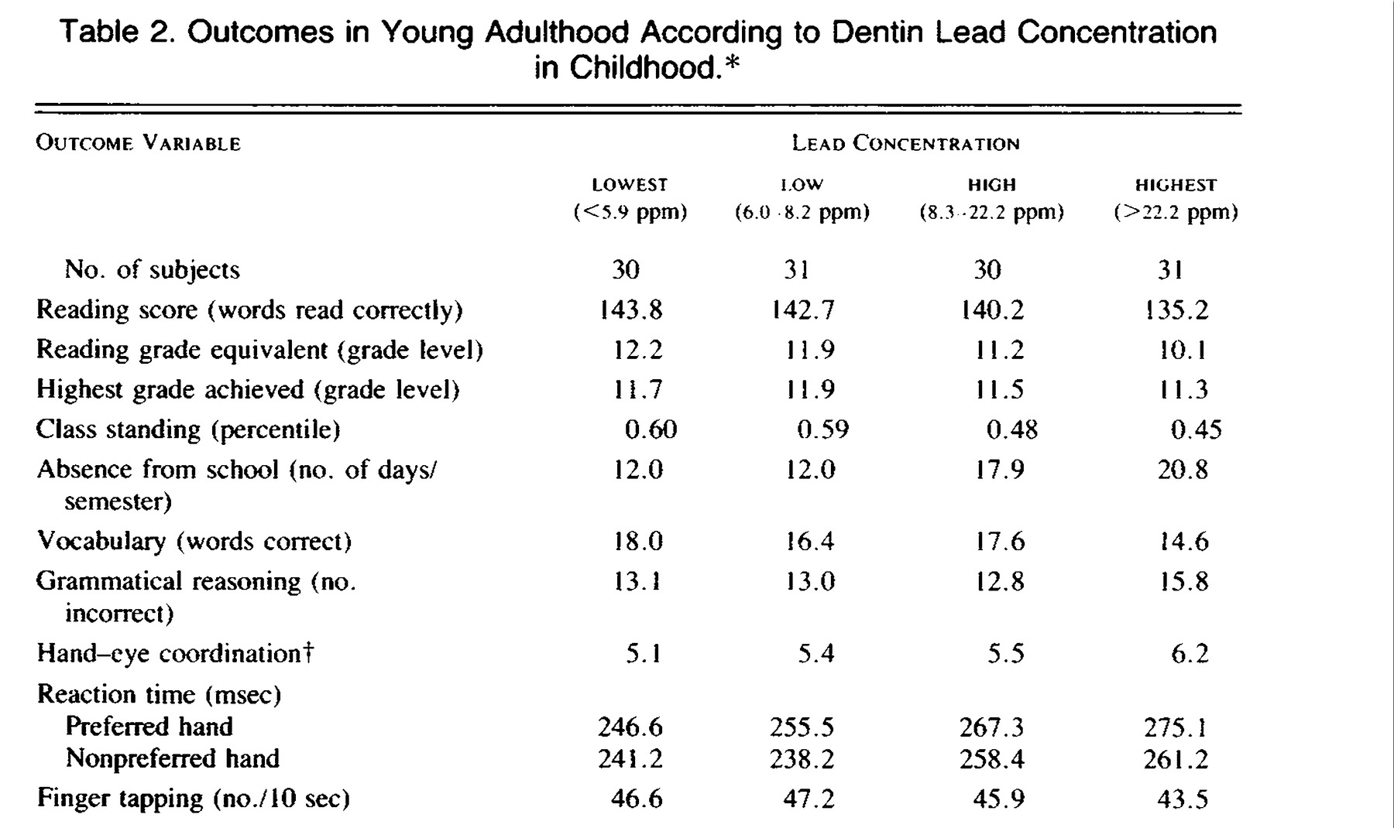
LEAD EXPOSURE vs CRIME RATES
Lead
Behavior
Crime
LEAD VS BEHAVIOR
Lead exposure can affect how the brain develops, leading to the difficulty controlling impulses and thinking clearly
Early-life exposure has more severe and persistent effects on cognition and behavior
BEHAVIOR VS CRIME
The link between aggression and antisocial behavior is obvious
Decreased levels of impulse are largely responsible for the increasing prevalence of juvenile delinquents and adult criminals
A study by Needleman et al (1996)
** The data suggests that lead exposure, even in asymptomatic children can have long-term effects on their success in life

Slide 9

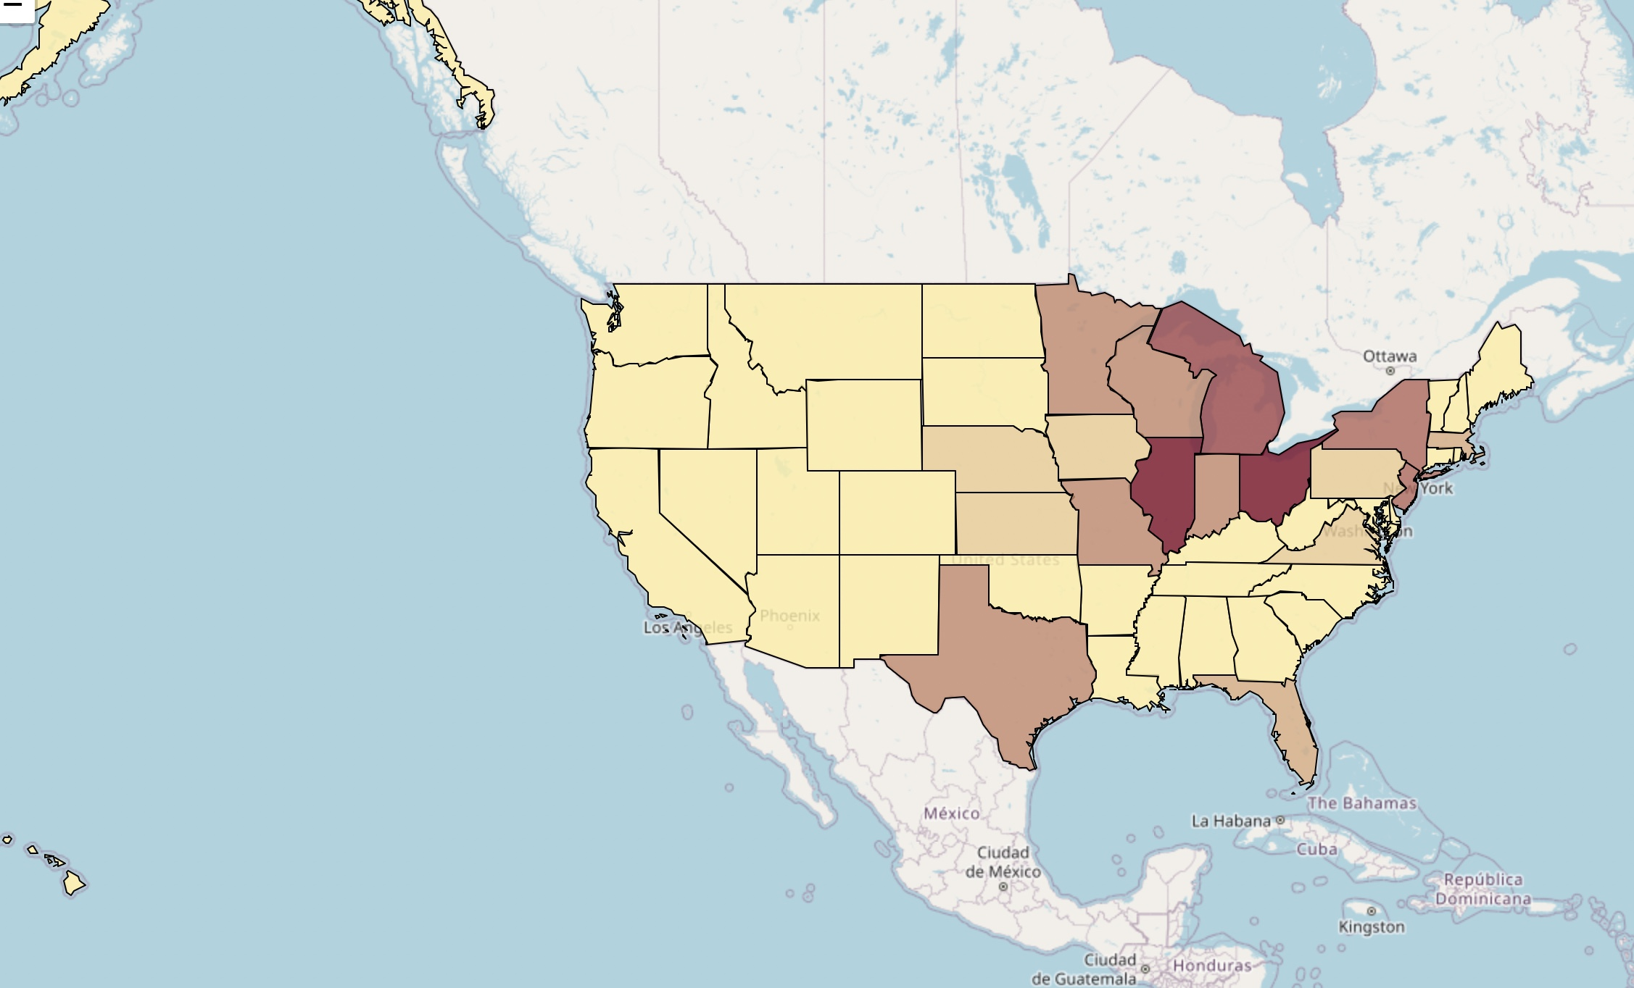
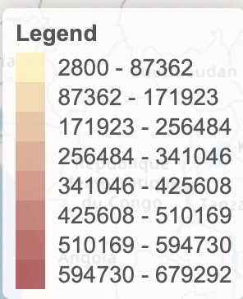
TOTAL LEAD SERVICE LINES (HIGH ESTIMATE) BY STATE
Highest number of LSLs | Lowest number of LSLs | Highest number of LSLs per 100k ppl
Illinois (679,292) | Hawaii (2800) | Wisconsin (5597)
Ohio (650,000) | Alaska (3800) | Ohio (5509)
Notes:
This information (geomap) could be used to identify which states have the highest potential for lead exposure in their drinking water due to the presence of Lead Service Lines.
According to the dataframe and geomap, Illinois and Ohio have the highest number of Lead Service Lines with the respectively estimated total of 679,292 and 650,000.

Slide 10
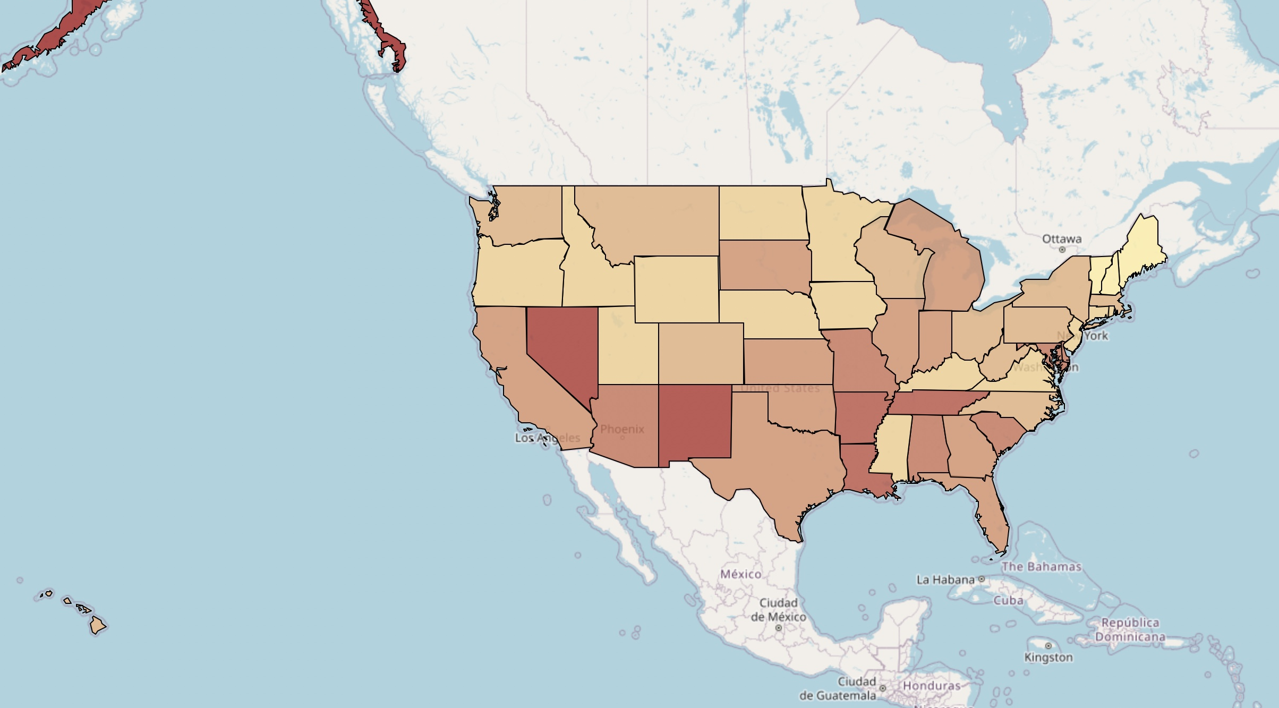
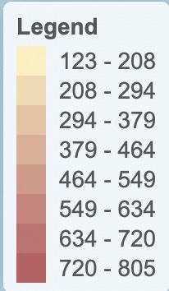
VIOLENT CRIME RATE BY STATE
Highest # of violent crime | Lowest # of violent crime
Alaska (804.2) | Maine (123.8)
New Mexico (702.5) | Vermont (158.3)

Slide 11
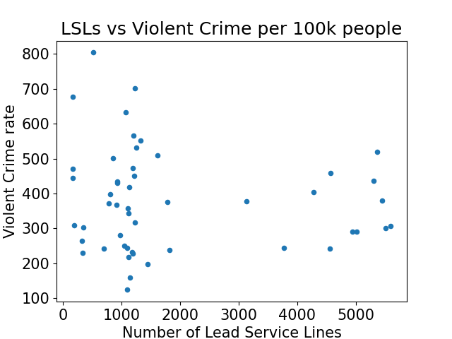
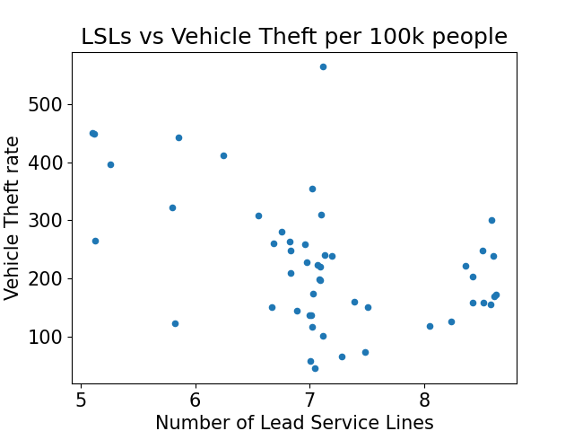
Notes:
From the first scatter plot (LSLs vs Violent Crime per 100k people), we can observe that there is no clear correlation between the number of lead service lines and the rate of violent crime. The data points are scattered and do not show any clear linear or nonlinear pattern. Therefore, we cannot conclude that there is a significant relationship between these two variables based on this plot.
On the second plot which shows the relationship between # of lead service lines and vehicle theft per 100 people, The scatter plot suggests a weak positive correlation between the two variables, as the points appear to have a slight upward trend but are widely scattered. There might be a slight tendency for states with higher numbers of lead service lines to also have higher vehicle theft rates, but the relationship is not strong and there is significant variation in vehicle theft rates across all levels of lead service lines.

Slide 12
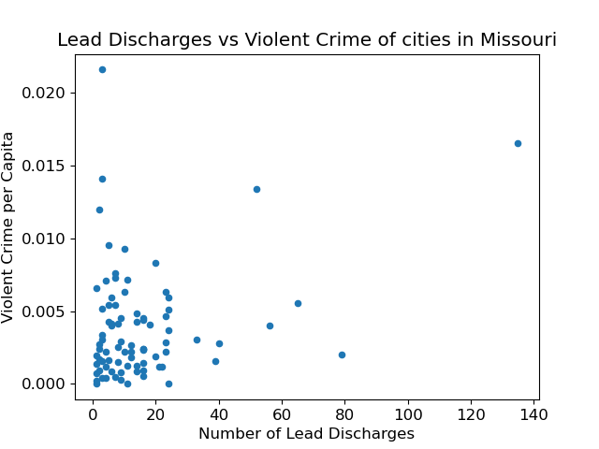
Notes:
According to data from the Centers for Disease Control and Prevention (CDC), Missouri has a higher percentage of children with elevated blood lead levels (EBLLs) than the national average. In 2018, the most recent year for which data is available, Missouri had a rate of 2.1% of children under 6 years old with EBLLs, compared to the national rate of 1.2%.

Slide 13
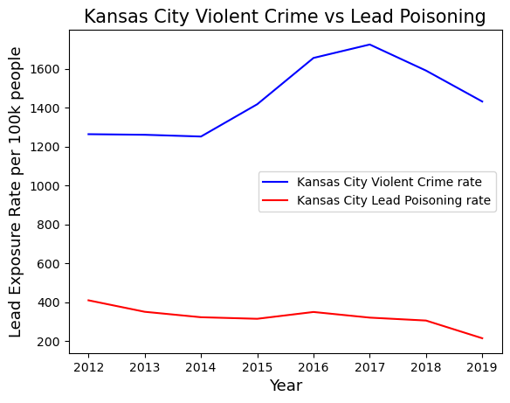
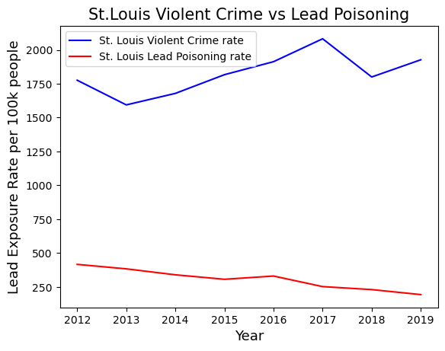
**According to a report found in 2019, St. Louis had the highest rate of lead poisoning among children in the state, with a rate of 4.4% of children tested having elevated blood lead levels (EBLLs)
* Kansas City had a slightly lower rate of 4.1%

Slide 14
LIMITATIONS AND CHALLENGES
INCOMLETE RECORDS
CONDUCTING LONGTIDIAL STUDY
Lead exposure is measured retrospectively, leading to inaccuracies
May be a challenge in understanding the long-term effects of lead exposure
ISOLATING DATA
ETHICAL CONCERNS
Difficult to isolate effects of lead exposure from other contributing factors (environmental, socioeconomic)
Exposing individuals intentionally to lead for research purposes
ADDRESSING ISSUES
DIRECT DATA SUPPORT HYPOTHESIS
Significant resources and political will are required
Difficulty in finding direct data to support the hypothesis that lead in water causes elevated levels of violence

Slide 15
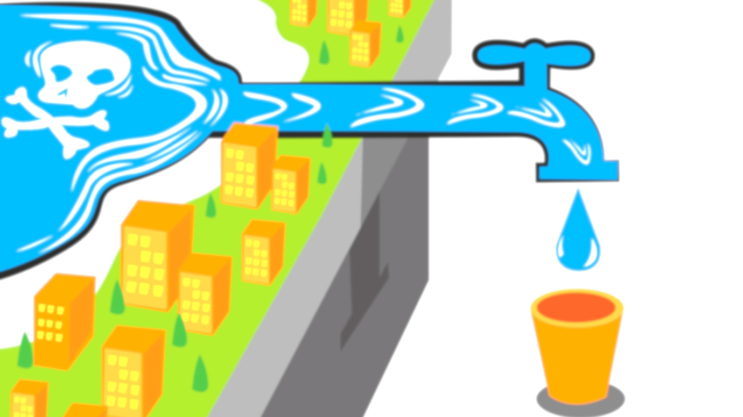
CONCLUSION

Slide 16
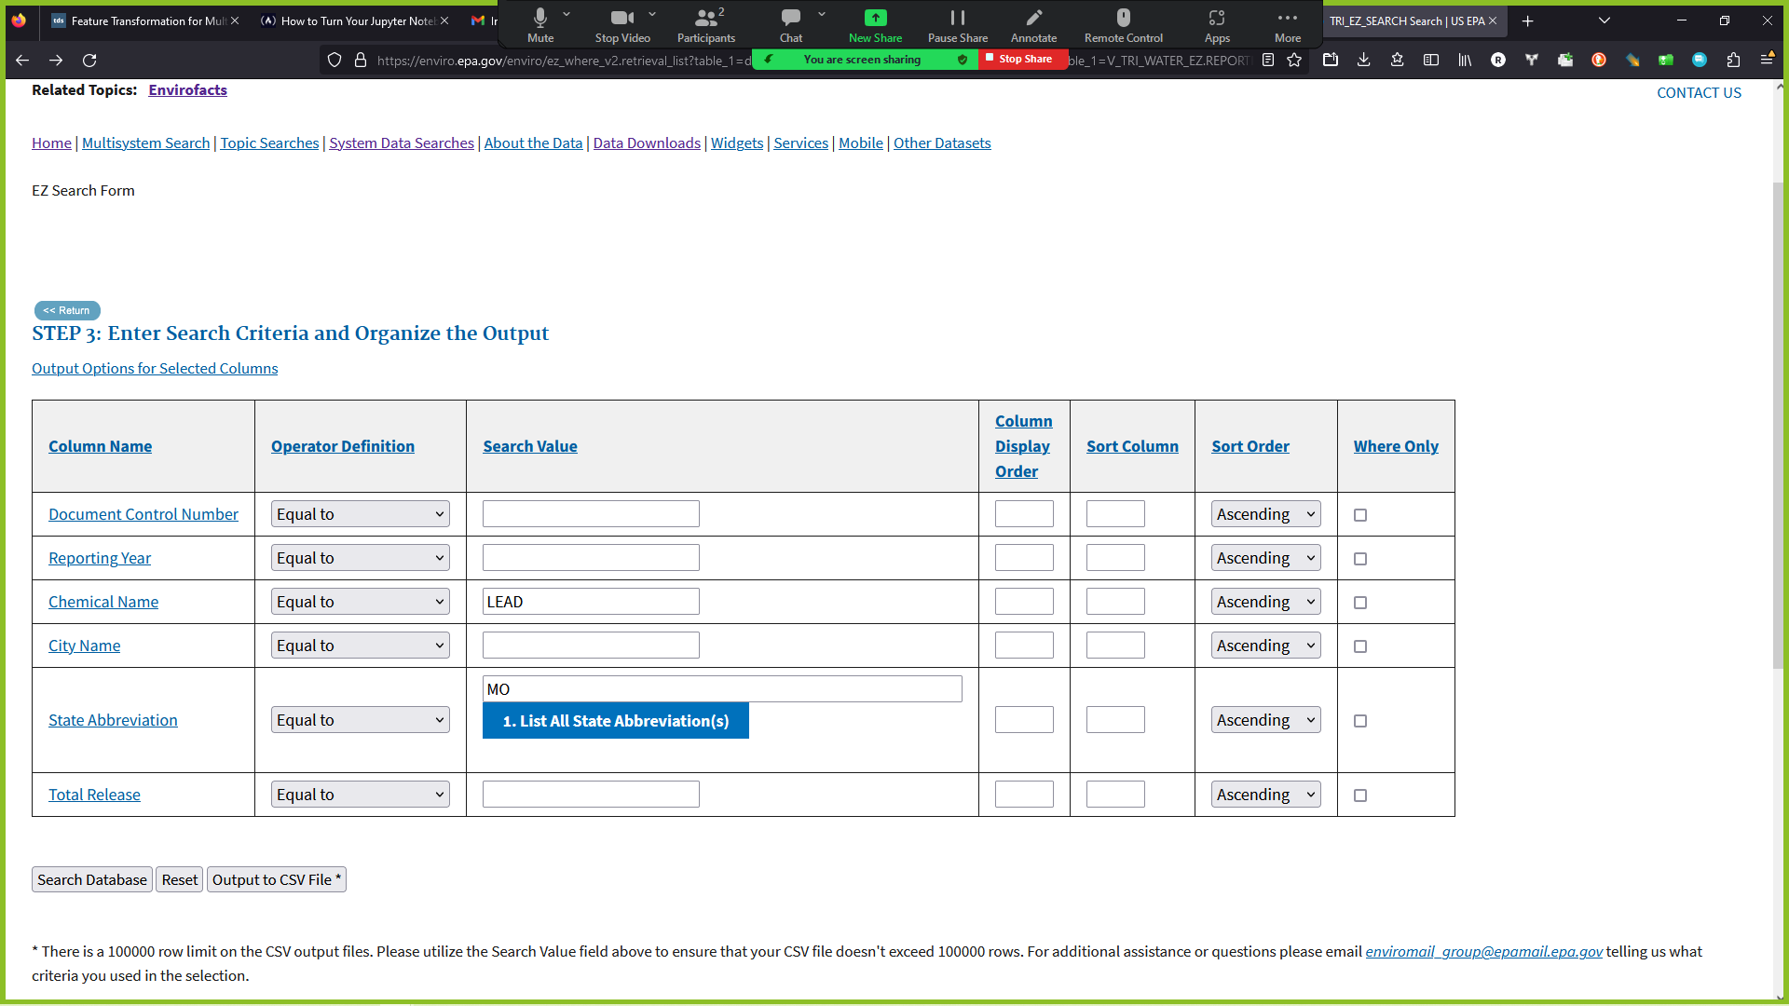
references
LINE OF INVESTIGATION 1
line of investigation 2
Setting used for epa tool
FBI state-by-state violence, 2016, https://ucr.fbi.gov/crime-in-the-u.s/2016/crime-in-the-u.s.-2016/topic-pages/tables/table-3
Lead service line data by state, https://www.nrdc.org/resources/lead-pipes-are-widespread-and-used-every-state
Missouri city-by-city violence, 2016, https://ucr.fbi.gov/crime-in-the-u.s/2016/crime-in-the-u.s.-2016/tables/table-6/table-6-state-cuts/missouri.xls
EPA chemical discharge into water tool, https://enviro.epa.gov/enviro/ez_column_v2.list?database_type=TRI&table_name=V_TRI_WATER_EZ

